Slide 1
Predictive Maintenance of Industrial Motors Using Multi Sensor Data
Mini Project
Team No: 10
Guide: Prof. Neethu K.N
Group Members
R23EN111 – Rachana Shettar
R23EN091 – Mythri RN
R23EN040 – Darshan D Telsang

Slide 2
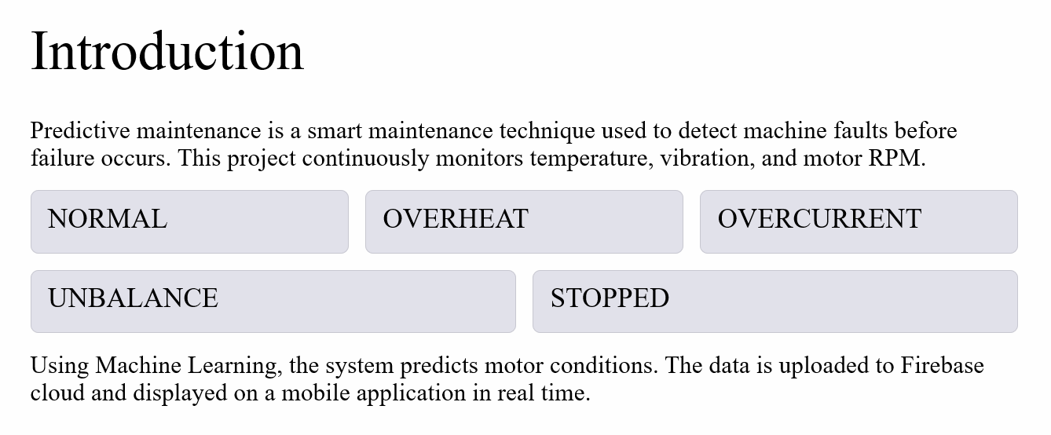

Slide 3
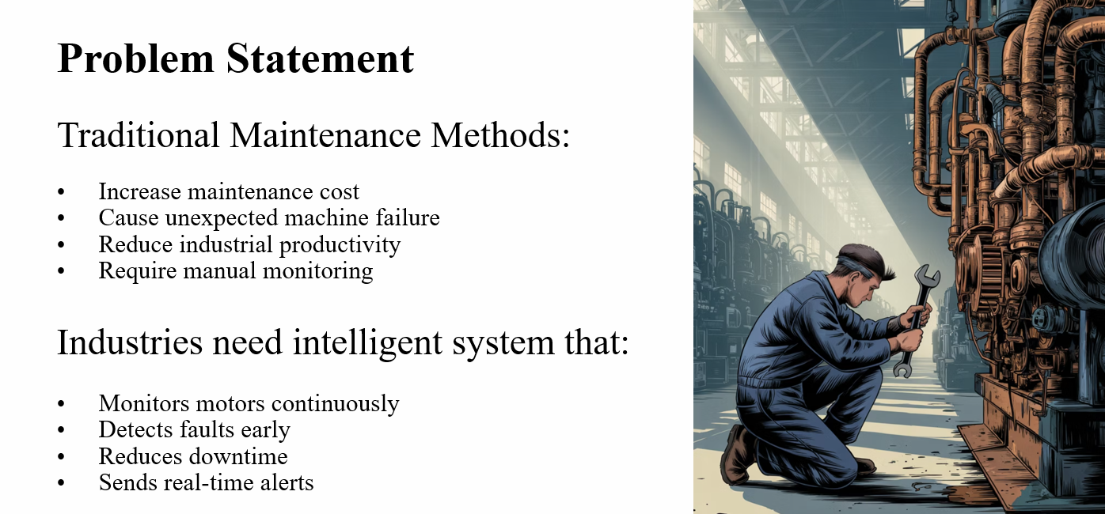

Slide 4
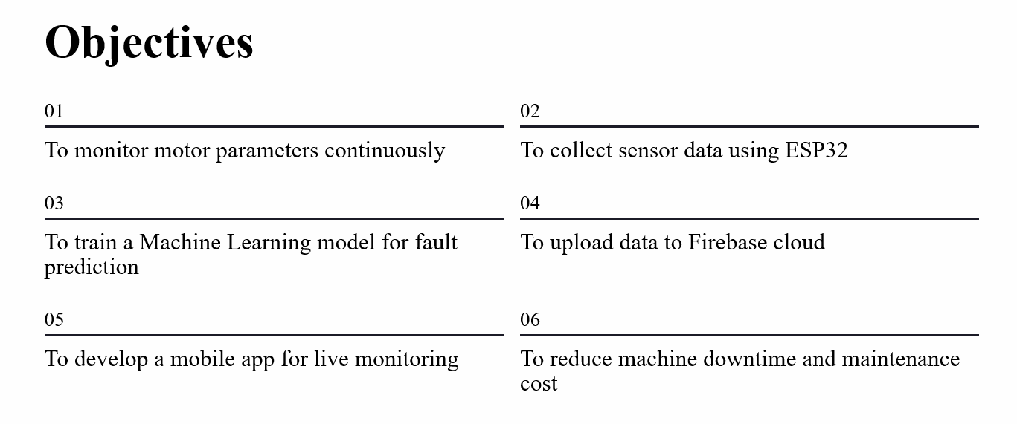

Slide 5
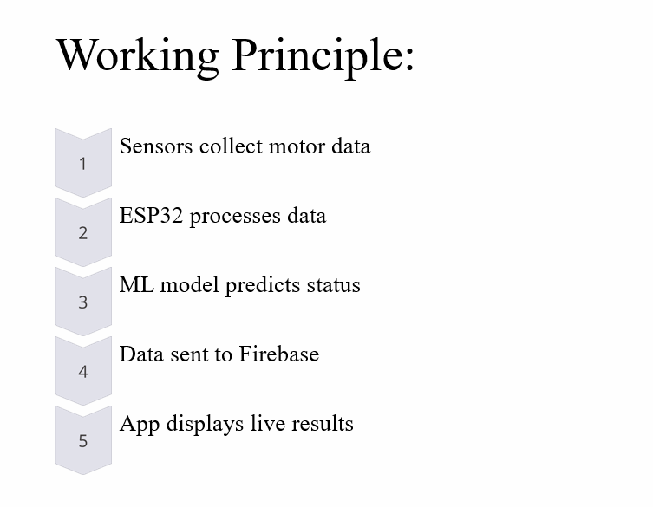

Slide 6
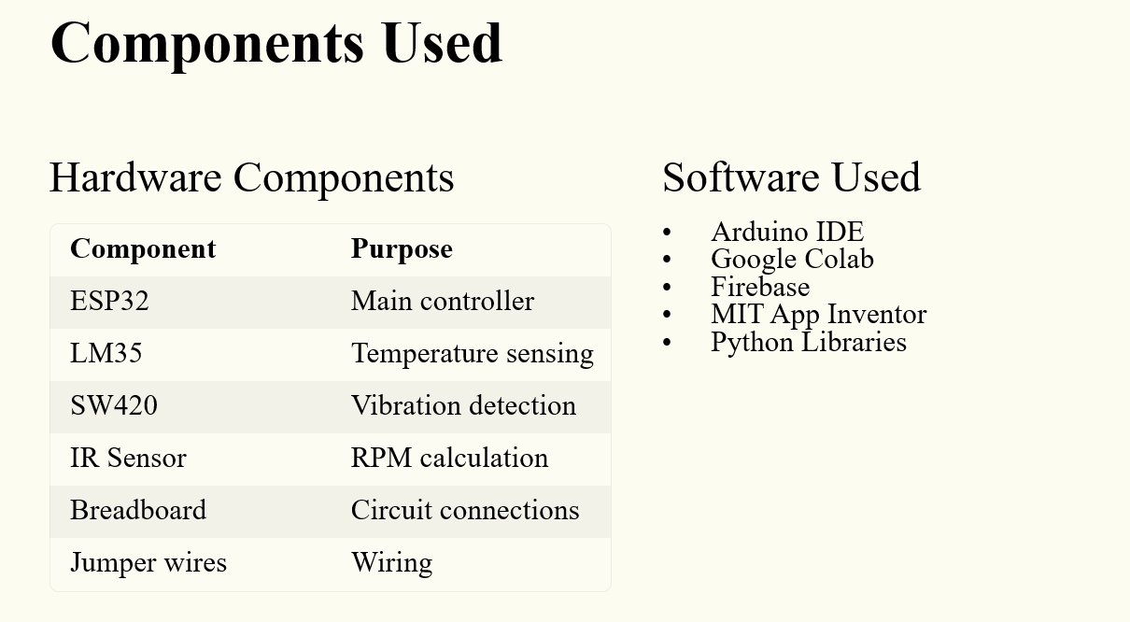

Slide 7
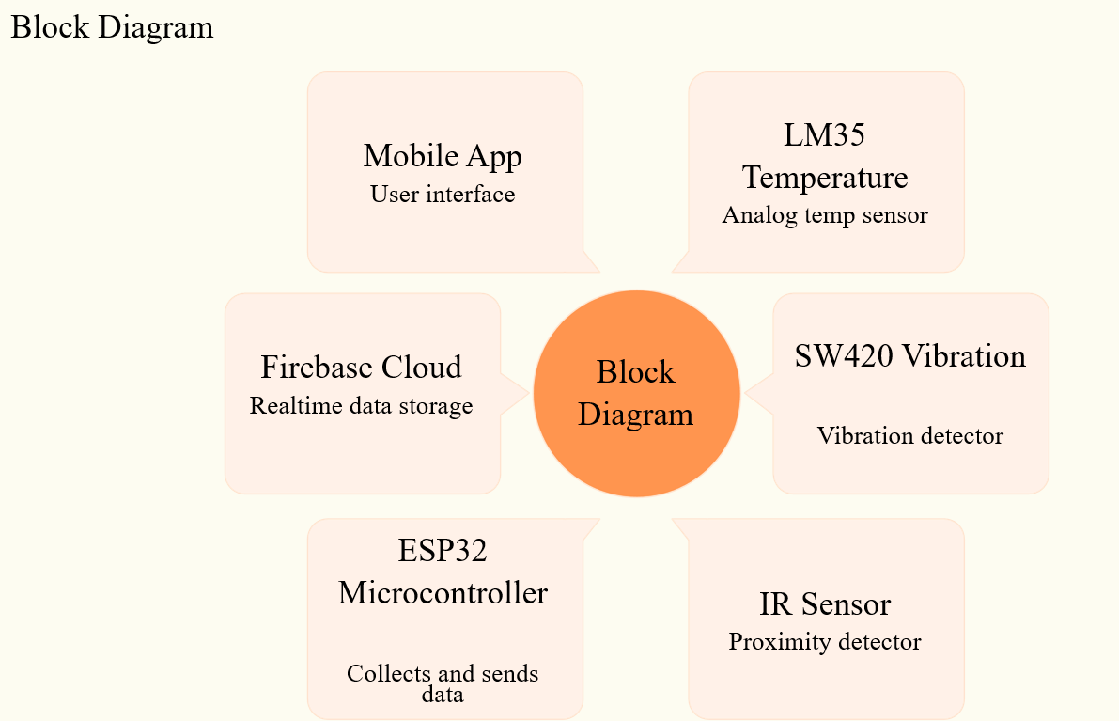

Slide 8
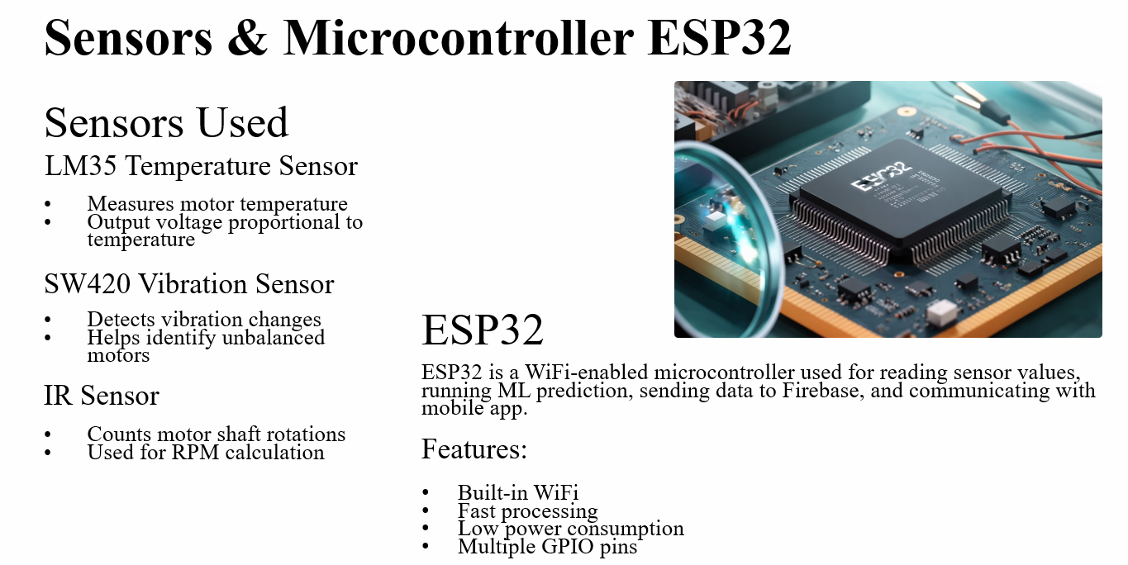

Slide 9
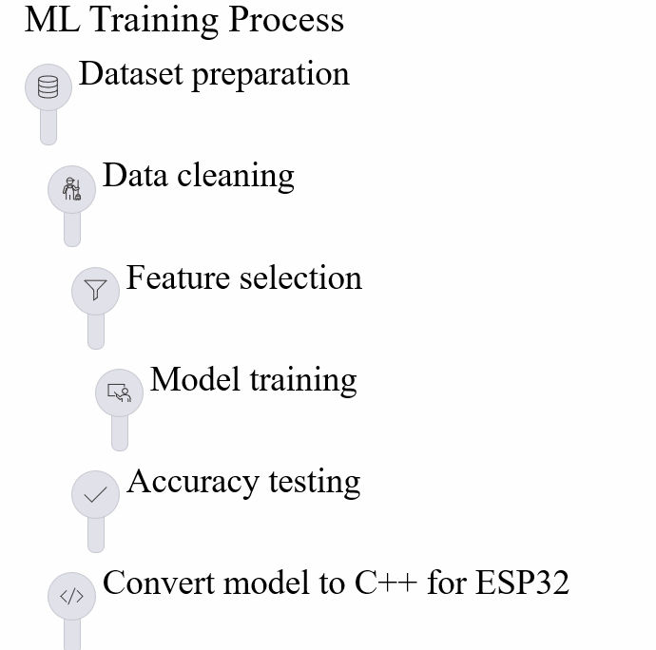

Slide 10
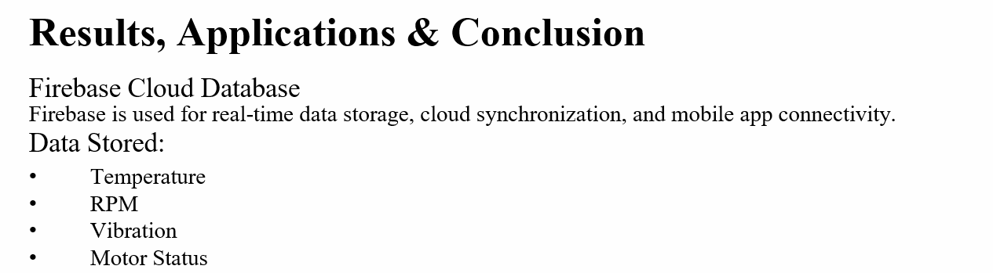

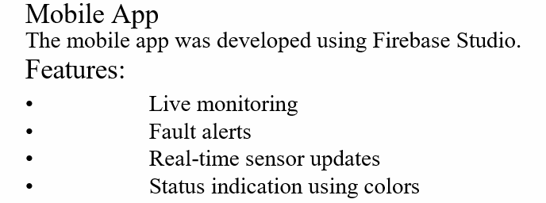

Slide 11
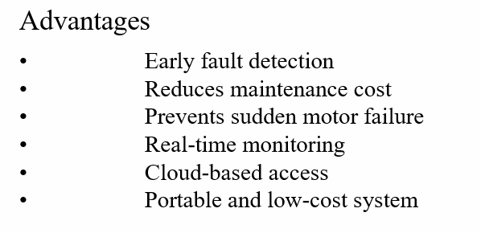
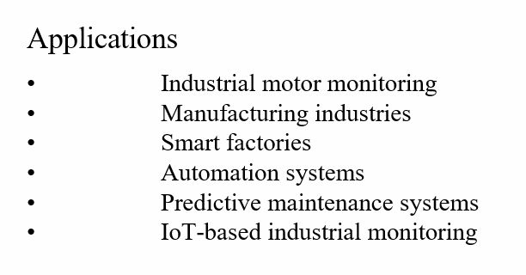
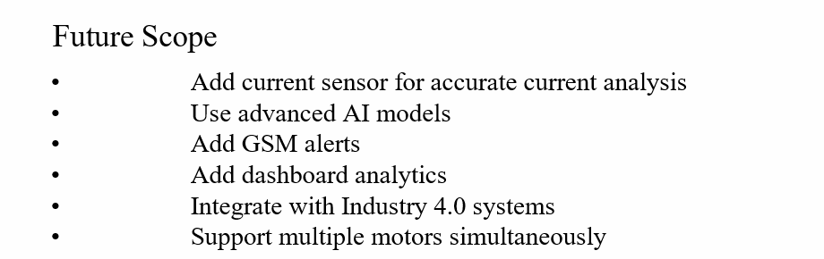

Slide 12
Results
Achievements:
Successful sensor monitoring
Real-time cloud update
Accurate ML prediction
Mobile app visualization
Fault alert generation
Model Accuracy:
Around 85%–95% accuracy achieved using Random Forest algorithm.

Slide 13
cOnclusion
The Predictive Maintenance System successfully monitors motor health using IoT and Machine Learning.
The system:
Predicts faults early
Improves industrial safety
Reduces downtime
Enables smart maintenance
This project demonstrates the practical implementation of Industry 4.0 concepts using ESP32 and Machine Learning.

Slide 14
References
[1] M. Valtierra-Rodriguez, J. R. Rivera-Guillen, J. A. Basurto-Hurtado, J. J. De-Santiago-Perez, D. Granados-Lieberman, and J. P. Amezquita-Sanchez, “Convolutional neural network and motor current signature analysis during the transient state for detection of broken rotor bars in induction motors,” Sensors, vol. 20, no. 13, p. 3721, 2020.
[2] X. Song, J. Hu, H. Zhu, and J. Zhang, “A bearing outer raceway fault detection method in induction motors based on instantaneous frequency of the stator current,” IEEJ Transactions on Electrical and Electronic Engineering, vol. 13, no. 3, pp. 510–516, 2018.
[3] K. D. Kompella, M. V. G. Rao, and R. S. Rao, “Bearing fault detection in a 3-phase induction motor using stator current frequency spectral subtraction with various wavelet decomposition techniques,” Ain Shams Engineering Journal, vol. 9, no. 4, pp. 2427–2439, 2018.
[4] L. Collamati, F. Filippetti, G. Franceschini, S. Pirani, and C. Tassoni, “Induction machine stator fault on-line diagnosis based on LabVIEW environment,” pp. 495–498.
[5] A. Sharotry, J. A. Jimenez, F. A. M. Mediavilla, D. Wierschem, R. M. Koldenhoven, and D. Valles, “Manufacturing operator ergonomics: A conceptual digital twin approach to detect biomechanical fatigue,” IEEE Access, vol. 10, pp. 12774–12791, 2022.

Slide 15
[6] J. Rodriguez et al., “Model predictive control: A review of its applications in power electronics,” IEEE Industrial Electronics Magazine, vol. 8, no. 1, pp. 16–31, Mar. 2014.
[7] R. Souad and H. Zeroug, “Comparison between direct torque control and vector control of a permanent magnet synchronous motor drive,” in Proc. 13th International Power Electronics and Motion Control Conference, Poznan, Poland, 2008, pp. 1209–1214.
[8] H. Wu, W. Zhao, M. Yu, and X. Wang, “Design and simulation of a model predictive control system for a novel dual-rotor flux switching permanent magnet motor,” in Proc. IEEE International Conference on Predictive Control of Electrical Drives and Power Electronics (PRECEDE), 2021.
[9] S. Pandey, D. Srivastava, R. Maurya, and M. S. Khan, “Predictive maintenance for industrial equipment (motor) using IoT,” in Proc. 3rd International Conference on Communication, Security, and Artificial Intelligence (ICCSAI), 2025.
[10] Z. Zoubaidi, B. Herrou, and S. Sekkat, “A new predictive maintenance system based on the LSTM model: Case study of motor production line,” in Proc. International Conference on Circuit, Systems and Communication (ICCSC), 2025.
[11] A. Mahesh, B. A. Aadhavan, V. V. Meenaa, M. B. Omar, R. B. Ibrahim, N. F. Salehuddin, and R. Sujatha, “Employment of ANN for predictive motor maintenance and bearing fault detection using Park’s vector analysis,” in Proc. IEEE 5th International Symposium in Robotics and Manufacturing Automation (ROMA), 2022.

Slide 16
[12] Z. Liu, T. Yuan, X. Zhou, X. Yuan, Y. Wang, and X. Zhang, “Research on predictive maintenance technology of stepping motor based on load value analysis,” in Proc. Chinese Automation Congress (CAC), 2020.
[13] C. Patil, S. K. Jadhav, A. L. Bardiya, and M. P. Raverkar, “Machine learning-based predictive maintenance of industrial machines,” vol. 71, Mar. 2023.
[14] N. K. J. L. Krishnakumar, G. Muhammad Aadhil, and A. V. P., “Predictive maintenance of motors using machine learning,” vol. 9, Apr. 2024.
[15] ISO, ISO 55000: Asset Management – Overview, Principles, and Terminology, International Organization for Standardization, 2024.
[16] J. Selech, J. Matijosius, A. Kilikevicius, and D. Marinkovic, “Reliability analysis and the costs of corrective maintenance for a component of a fleet of trams,” Tehnicki Vjesnik, vol. 32, no. 1, pp. 205–216, 2025.

Slide 17
Thank You

